Slide 1
Software Design and Coding

Slide 2
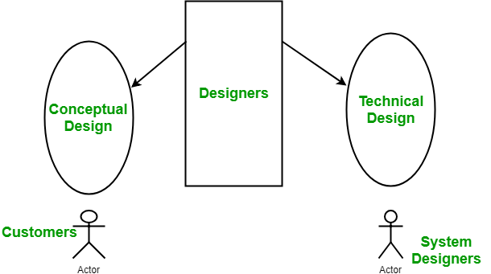

Slide 3
Conceptual design of the system:
Written in simple language i.e. customer understandable language.
Detailed explanation about system characteristics.
Describes the functionality of the system.
It is independent of implementation.
Linked with requirement document.
Technical Design of the system:
Hardware component and design.
Functionality and hierarchy of software components.
Software architecture
Network architecture
Data structure and flow of data.
I/O component of the system.
Shows interface.

Slide 4
Design Process
Software design process can be perceived as series of well-defined steps. Though it varies according to design approach (function oriented or object oriented.
It may have the following steps involved:
A solution design is created from requirement or previous used system and/or system sequence diagram.
Objects are identified and grouped into classes on behalf of similarity in attribute characteristics.
Class hierarchy and relation among them are defined.
Application framework is defined.

Slide 5
Design Approaches
Top down Design:
Top-down design takes the whole software system as one entity and then decomposes it to achieve more than one sub-system or component based on some characteristics. Each sub- system or component is then treated as a system and decomposed further. This process keeps on running until the lowest level of system in the top-down hierarchy is achieved.
Top-down design starts with a generalized model of system and keeps on defining the more specific part of it. When all components are composed the whole system comes into existence.
Top-down design is more suitable when the software solution needs to be designed from scratch and specific details are unknown.

Slide 6
Bottom-Up Design:
The bottom up design model starts with most specific and basic components. It proceeds with composing higher level of components by using basic or lower level components.
It keeps creating higher level components until the desired system is not evolved as one single component. With each higher level, the amount of abstraction is increased.
Bottom-up strategy is more suitable when a system needs to be created from some existing system, where the basic primitives can be used in the newer system

Slide 7
Modularization: Modularization is the process of dividing a software system into multiple independent modules where each module works independently. There are many advantages of Modularization in software engineering. Some of these are given below:
Easy to understand the system.
System maintenance is easy.
A module can be used many times as their requirements. No need to write it again and again.

Slide 8
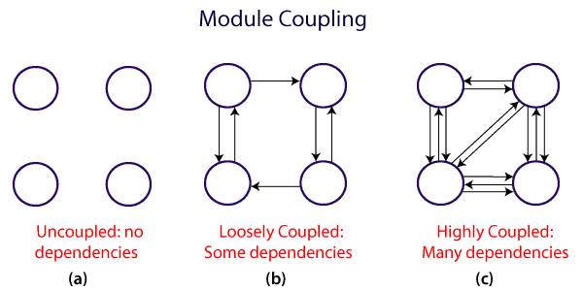
Module Coupling
In software engineering, the coupling is the degree of interdependence between software modules. Two modules that are tightly coupled are strongly dependent on each other. However, two modules that are loosely coupled are not dependent on each other. Uncoupled modules have no interdependence at all within them.

Slide 9
A good design is the one that has low coupling.
Coupling is measured by the number of relations between the modules. That is, the coupling increases as the number of calls between modules increase or the amount of shared data is large.
Thus, it can be said that a design with high coupling will have more errors.

Slide 10
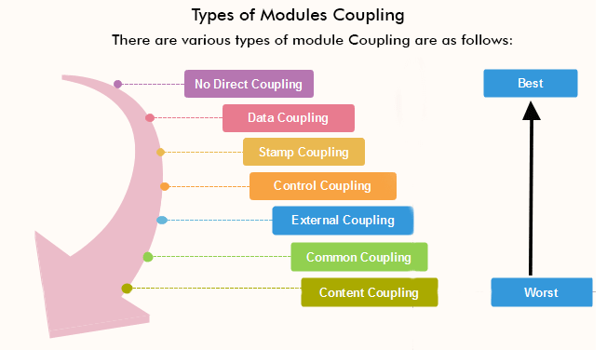

Slide 11
No Direct Coupling: There is no direct coupling between M1 and M2
Data Coupling: When data of one module is passed to another module, this is called data coupling.
Stamp Coupling: Two modules are stamp coupled if they communicate using composite data items such as structure, objects, etc.
Control Coupling: Control Coupling exists among two modules if data from one module is used to direct the structure of instruction execution in another.
External Coupling: External Coupling arises when two modules share an externally imposed data format, communication protocols, or device interface. This is related to communication to external tools and devices.
Common Coupling: Two modules are common coupled if they share information through some global data items.
Content Coupling: Content Coupling exists among two modules if they share code, e.g., a branch from one module into another module.

Slide 12
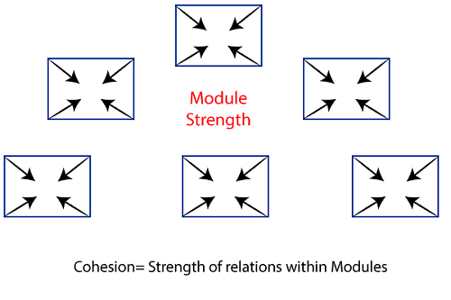
Module Cohesion
In computer programming, cohesion defines to the degree to which the elements of a module belong together. Thus, cohesion measures the strength of relationships between pieces of functionality within a given module. Cohesion is an ordinal type of measurement and is generally described as "high cohesion" or "low cohesion."

Slide 13
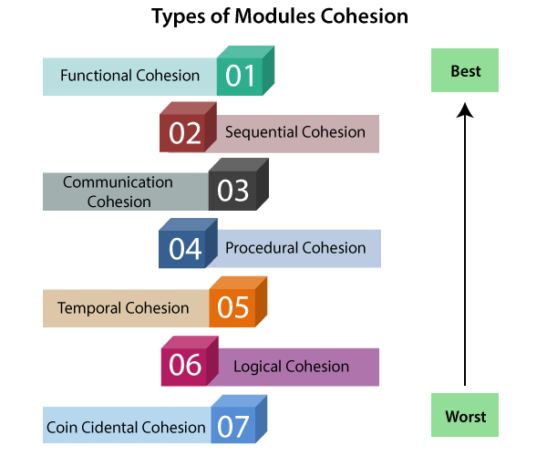

Slide 14
Functional Cohesion: Functional Cohesion is said to exist if the different elements of a module, cooperate to achieve a single function.
Sequential Cohesion: A module is said to possess sequential cohesion if the element of a module form the components of the sequence, where the output from one component of the sequence is input to the next.
Communicational Cohesion: A module is said to have communicational cohesion, if all tasks of the module refer to or update the same data structure, e.g., the set of functions defined on an array or a stack.
Procedural Cohesion: A module is said to be procedural cohesion if the set of purpose of the module are all parts of a procedure in which particular sequence of steps has to be carried out for achieving a goal, e.g., the algorithm for decoding a message.
Temporal Cohesion: When a module includes functions that are associated by the fact that all the methods must be executed in the same time, the module is said to exhibit temporal cohesion.
Logical Cohesion: A module is said to be logically cohesive if all the elements of the module perform a similar operation. For example Error handling, data input and data output, etc.
Coincidental Cohesion: A module is said to have coincidental cohesion if it performs a set of tasks that are associated with each other very loosely, if at all.

Slide 15
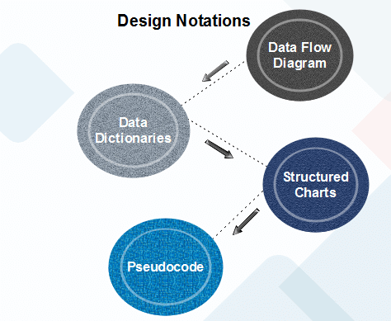
Function Oriented Design
Function Oriented design is a method to software design where the model is decomposed into a set of interacting units or modules where each unit or module has a clearly defined function. Thus, the system is designed from a functional viewpoint.

Slide 16
User Interface Design
The visual part of a computer application or operating system through which a client interacts with a computer or software. It determines how commands are given to the computer or the program and how data is displayed on the screen.
Types of User Interface
Text-Based User Interface or Command Line Interface
Graphical User Interface (GUI)

Slide 17
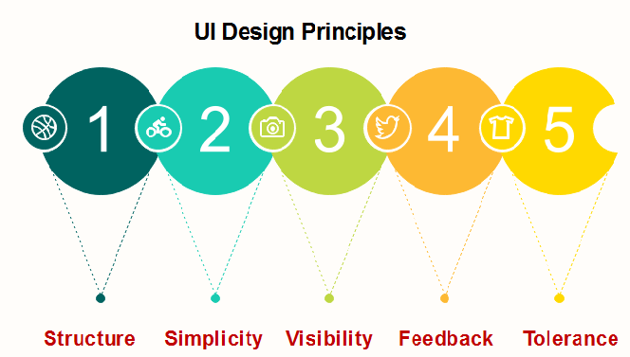
UI Design Principles

Slide 18
Coding
The coding is the process of transforming the design of a system into a computer language format.
This coding phase of software development is concerned with software translating design specification into the source code.
It is necessary to write source code & internal documentation so that conformance of the code to its specification can be easily verified.
Goals of Coding
To translate the design of system into a computer language format
To reduce the cost of later phases
Making the program more readable

Slide 19
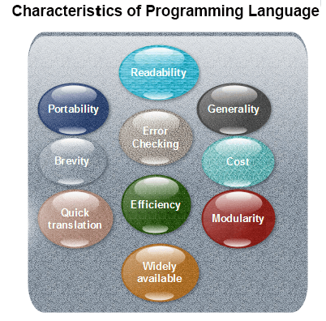

Slide 20
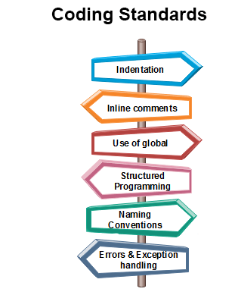

Slide 21
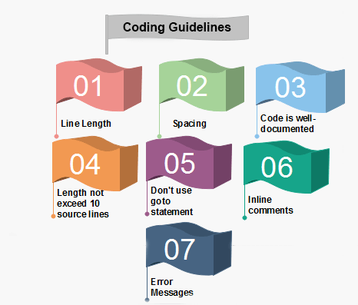

Slide 22
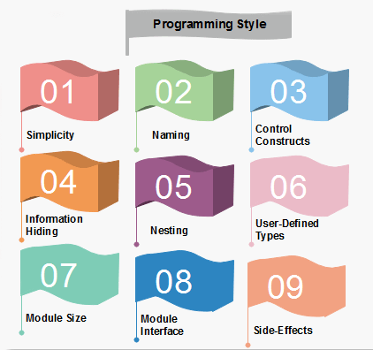

Slide 23
